Slide 1

Twitter Sentiment Analysis
By-
Aaryan P Dabhade
Anuja Bavkar
Sangram Dedge
Rishav Mondel
Prof- Yue Gao

Slide 2


Twitter
Twitter is a social media platform that enables users to post and interact with messages known as "tweets,“.
Twitter serves as a real-time information network, providing users with instant updates on news, events, trends, and discussions from around the world.
Twitter serve as vast repositories of public opinion and sentiment.

Slide 3
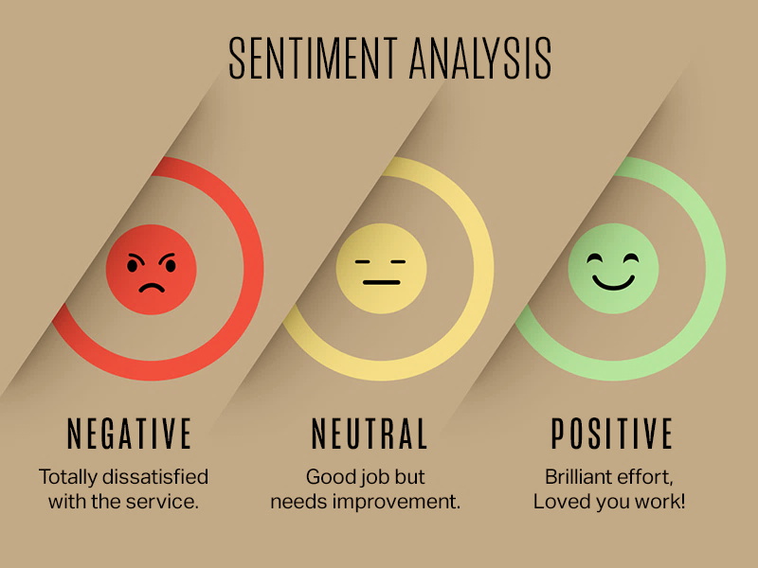
Sentiment Analysis
Sentiment analysis is a natural language processing (NLP) technique.
Helps determine the emotional tone or sentiment expressed in a piece of text.
Involves analyzing text data to classify it as positive, negative, or neutral based.

Slide 4
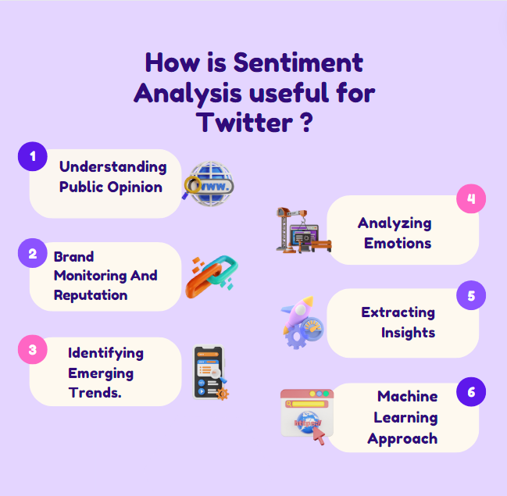



Slide 5


Data Description
1,600,000
It contains tweets extracted using the twitter api .
The tweets have been annotated as:
(0 = negative, 2 = neutral, 4 = positive)
3. It contains 6 variables as follows:
sentiment
flag
ids
user
date
text

Slide 6
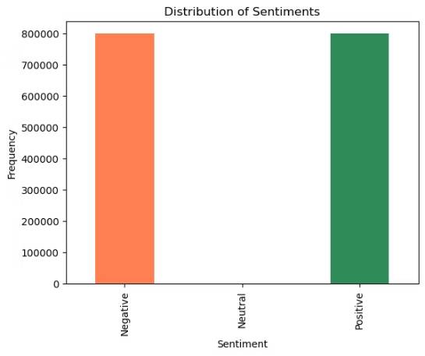
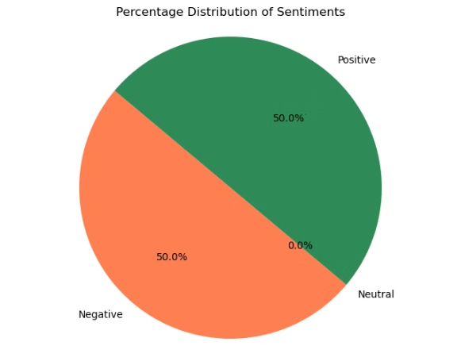
Data Visualization
Neutral
Positive
Negative
As we can see from the two plots, although there were 3 different categories of sentiment for the data, on 2 were actually present in the data, with no neutral sentiment available.

Slide 7
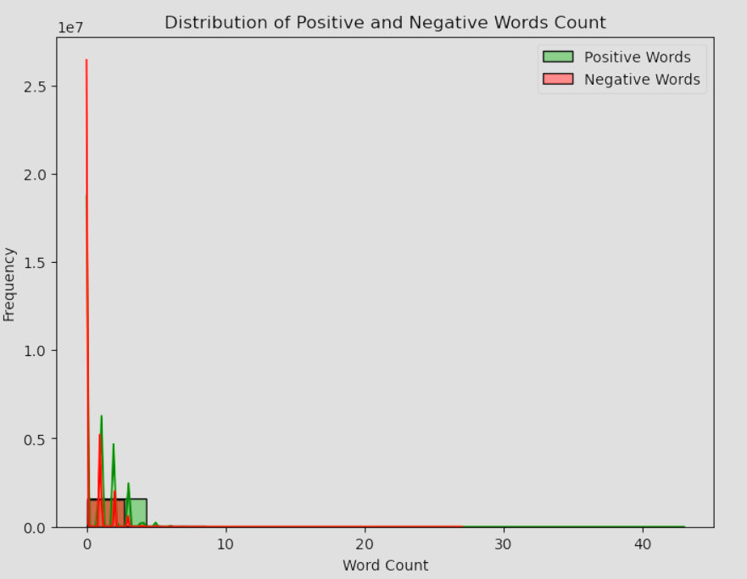
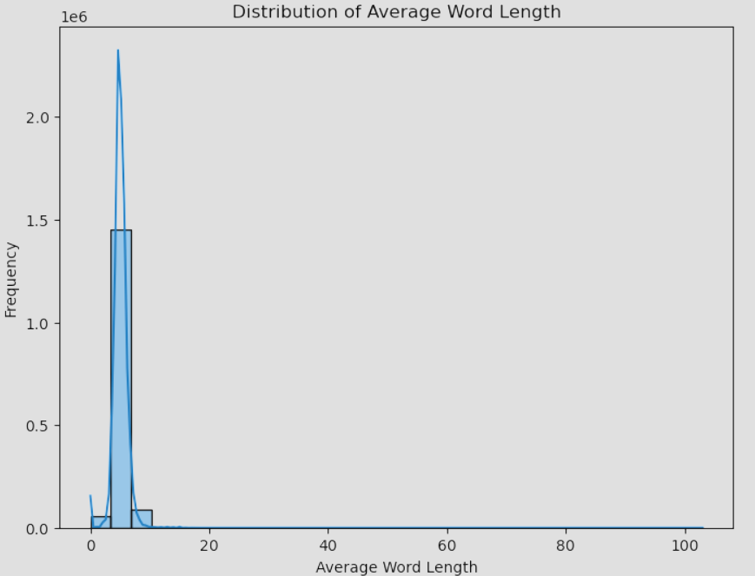
Data Visualization

Slide 8
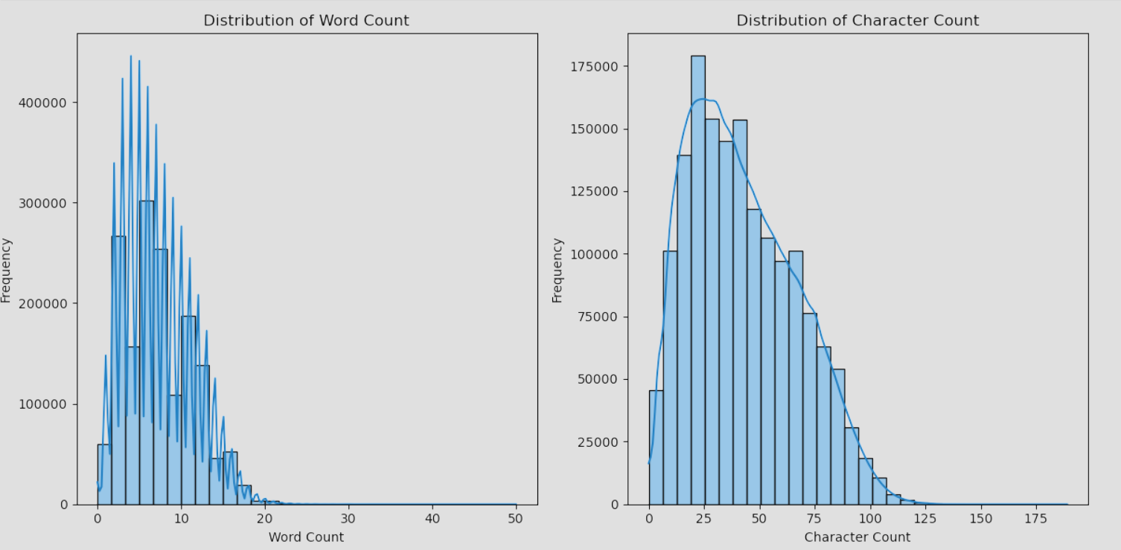
Data Visualization

Slide 9
Descriptive Statistics
Information
Statistics
# | Column | Non-Null Count | Dtype
0 | Sentiment | 1600000 | int64
1 | ids | 1600000 | int64
2 | date | 1600000 | object
3 | flag | 1600000 | object
4 | user | 1600000 | object
5 | text | 1600000 | object
# | Sentiment | ids
Count | 1.60000e+06 | 1.600000e+06
Mean | 2.00000e+00 | 1.99881e+09
Std | 2.00001e+00 | 1.93576e+08
Min | 0.00000e+00 | 1.46781e+09
25% | 0.00000e+00 | 1.95691e+09
50% | 2.00000e+00 | 2.02102e+09
75% | 4.00000e+00 | 2.17759e+09
Max | 4.00000e+00 | 2.32926e+09
Here we can see the various information regarding the dataset we used to perform the analysis
Shape
Columns | Rows
1600000 | 6

Slide 10
Descriptive Statistics
Unique values
Column | No of Unique Values
Sentiment | 2
ids | 1598315
Date | 774363
Flag | 1
User | 659775
Text | 1581466
Categorical stats
# | Date | Flag | User | Text
Count | 1600000 | 1600000 | 1600000 | 1600000
Unique | 774363 | 1 | 659775 | 1581466
Top | Mon Jun 15 | NO_QUERY | Log_dog | isPlayer Has Died! sorry
Frequency | 20 | 1600000 | 549 | 210
No missing values
Column | No of missing values
Sentiment | 0
ids | 0
Date | 0
Flag | 0
User | 0
Text | 0

Slide 11

Processing the Tweets
1
Data Cleaning
We cleaned the data by removing the unnecessary columns like ids, flag, date and user.
2
Preprocessing
We cleaned the text column further by removing hyper links and special characters. Then we added several other columns like word count, average word count, number of characters, and so on.
3
Tokenization
The text from the tweets were then broken into words and the above functions were performed .

Slide 12
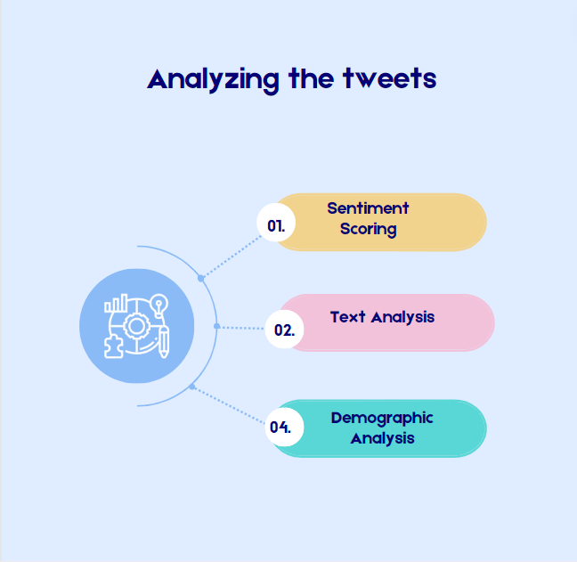
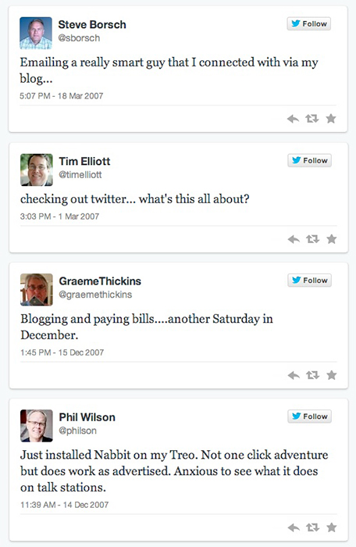


Slide 13

Methods
Variety of methods were used
Since this was a categorical dataset we only had to use classification models
The classification models used were K-NN, Decision Tree, Gradient Boosting, Random Forest and SVM
These models will be trained on the preprocessed dataset and their performance will be noted and compared. We will also compare the performance between the two types of learning mechanism.

Slide 14

METHODS & ACCURACY
DESISION TREE
GRADIENT BOOSTING
Accuracy – 66.31%
Accuracy – 66.61%
SVM
RANDOM FOREST
K-NN
Support Vector Machine
Accuracy – 66.32%
Accuracy – 66%
K Nearest Neighbor
Accuracy – 62.71%

Slide 15
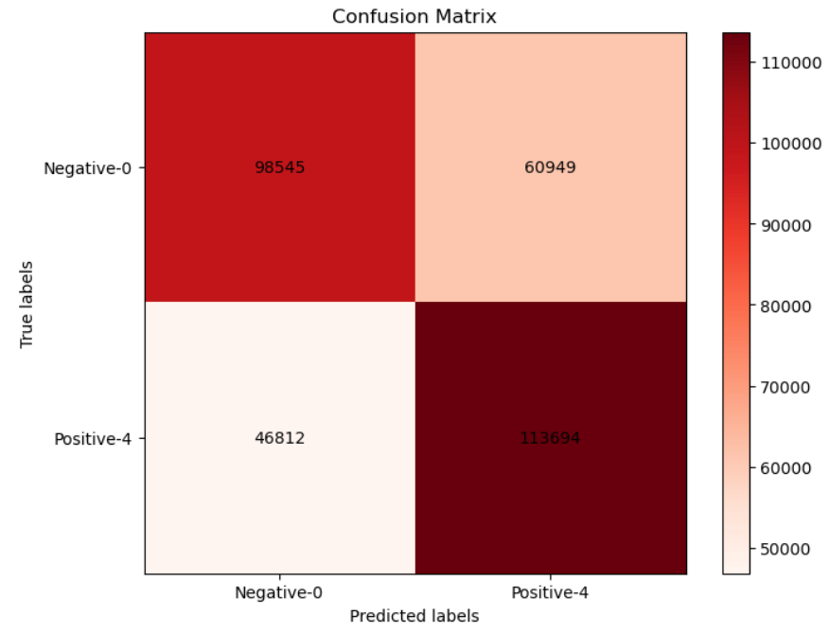
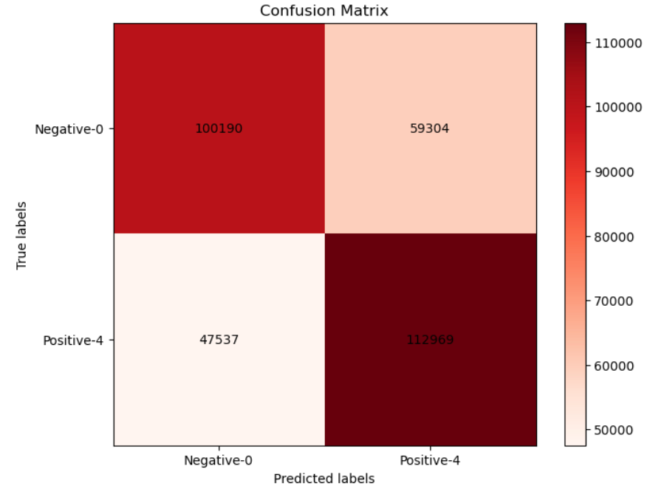
Selecting Two Methods With Highest Accuracy
Random Forest with accuracy of 66.32%
Confusion Matrix:
Gradient Boosting with accuracy of 66.61%
Confusion Matrix
98545 | 60949
46812 | 113694
100190 | 59304
47537 | 112969

Slide 16
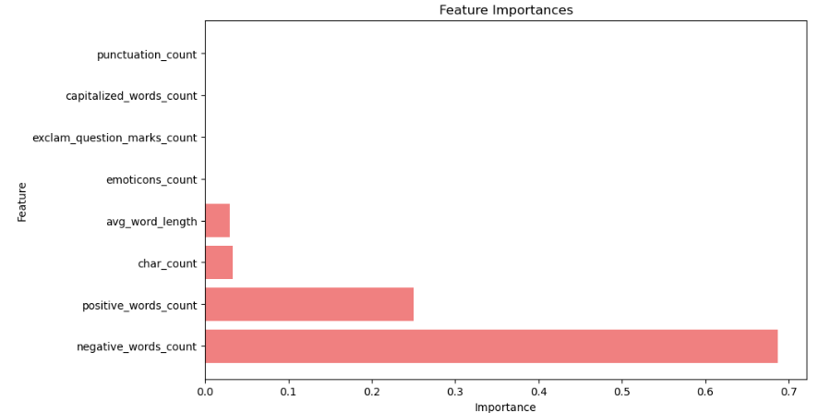
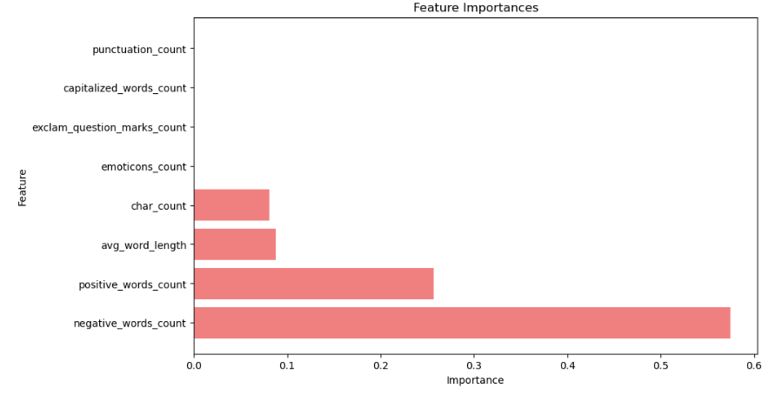
Features importance from Gradient Boosting
Features Importance from Random Forest

Slide 17
Challenges and Limitations
It can be challenging to understand the platform's informal, colloquial language.
Even sophisticated natural language processing algorithms can become confused by slang, irony, and intricate contextual clues.
Depending on one's viewpoint, the same text might express wildly disparate emotions.
Annotator bias and interpretation can play a major role in determining the emotional tone of a tweet, This may result in inconsistent labelling.
It is unable to distinguish between everyday language and sarcasm. Additionally, its capacity to manage word non-linearity is restricted.

Slide 18




Practical Implication
User mental state monitoring
Financial forecasting
Brand reputation management
Political polling

Slide 19

Conclusion and Future Directions
In this presentation, we have explored the powerful capabilities of sentiment analysis on Twitter data.
For future references I would like to see more powerful models to be used to get better results.
Natural Language Processing and Deep Learning models is the way to go for the future.
This would enable brands to properly analyze the user sentiment to adjust their marketing strategies accordingly. It would also help with properly analyzing the flow of support during voting season.

